Slide 1
DATS 6203 – Machine Learning II: Data Analysis Fall - 2021
Final Project : Detecting Fake Images
Dr. Amir Jafari
Mojahid Osman
Mina Hanna

Slide 2
Introduction
“An image is worth a thousand words” is the famous statement by Henrik Ibsen which implies the value and the impact of an image and how a complex message can be delivered with one visual rather than a lengthy verbal description.
On the other hand, a fake image can have a severe negative impact on the overall public respect and confidence in news and other social communications.

Slide 3
Project Objective:
This project focuses on Image tampering detection using Convolutional Neural Network (CNN) classification based on popular filters and analysis used in today’s forensic image analysis like:
Error Level Analysis (ELA)
Noise Analysis
Luminance Gradient Analysis.

Slide 4
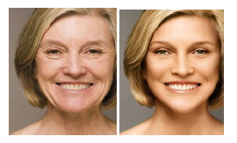
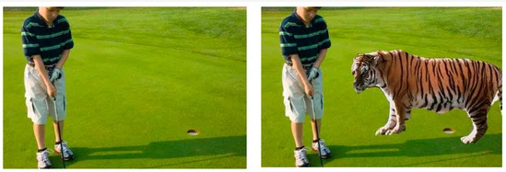
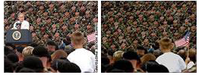
Digital image forensic:
Image tampering can be defined as “adding or removing important features from an image without leaving any obvious traces of tampering”
Image retouching: reduce or improve
certain features of the image
Copy-move: copy part of the image to hide
certain areas of shows areas several times
Image splicing: compose a new image using
fragments from same or different images

Slide 5
Dataset and the Exploratory Data Analysis:
The dataset used in this project is the PS-Battles dataset which is gathered from a large community of image manipulation enthusiasts and provides a basis for media derivation and manipulation detection in the visual domain
The dataset consists of 102,028 images grouped into 11,142 and 90,886 manipulated derivatives
Each original image has a corresponding sub directory (having the same image name) under the photoshopped directory that contains the manipulated version of this image
Original Images | Photoshopped Images | Total
11,142 | 90,886 | 102'028

Slide 6
Data Preprocessing:
Due to the big number of the Images dataset, we create a function to reduce the number of images randomly
Apply different filters to create different types of Dataset
Class01 – Original Images with no filter
Class02 – Apply ELA (Error Level Analysis)
Class03 – Luminance Gradient Analysis
Class04 - Noise Analysis

Slide 7
Model definition and building network:
Why CNN for Image Classification?
Using an ANN for the purpose of image classification would end up being very costly in terms of computation since the trainable parameters become extremely large.
For example, if we have a 50 X 50 image of a cat, and we want to train our traditional ANN on that image to classify it into a dog or a cat the trainable parameters become – (50*50) * 100 image pixels multiplied by hidden layer + 100 bias + 2 * 100 output neurons + 2 bias = 2,50,302.

Slide 8
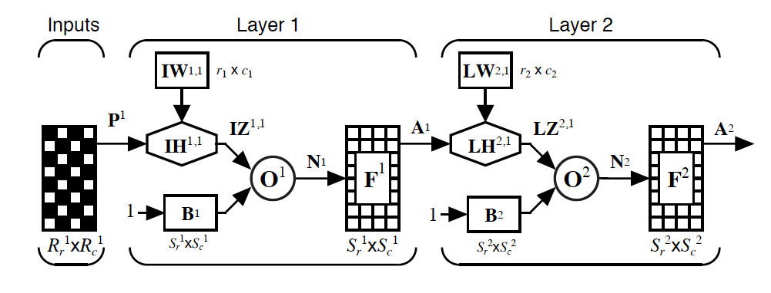
Model definition and building network:
Convolutional Neural Networks come under the subdomain of Machine Learning which is Deep Learning. It was proposed by computer scientist Yann LeCun in the late 90s, when he was inspired from the human visual perception of recognizing things.
A convolution network is a multilayer feedforward network that has two- or three-dimensional inputs. It has weight functions that are not generally viewed as matrix multiplication (or inner product) operations, The principal layer type for convolution networks is the convolution layer.

Slide 9
Model definition and building network:
Convolutional Neural Networks come under the subdomain of Machine Learning which is Deep Learning. It was proposed by computer scientist Yann LeCun in the late 90s, when he was inspired from the human visual perception of recognizing things.
A convolution network is a multilayer feedforward network that has two- or three-dimensional inputs. It has weight functions that are not generally viewed as matrix multiplication (or inner product) operations, The principal layer type for convolution networks is the convolution layer.

Slide 10
Model definition and building network:
TensorFlow:
TensorFlow and PyTorch frameworks are both very useful abstractions and reduce a decent amount of code and speed up model development.
In this project we choose to use TensorFlow however we feel It will fit our needs and it has the most features we need to develop our model in a simple way.

Slide 11
Model definition and building network:
Step 1: Data Preprocessing:
Working with Images forensic fakes classification there is no straight way to use a model that fit with all types of photoshopped or fakes images, so we start to apply different filters to the images and apply model to see which model work best with which type of filter to give a better results. So, we end up with 4 different class of data:
Class01 – Original Images with no filter
Class02 – ELA (Error Level Analysis)
Class03 – Noise Analysis
Class04 – Grading Analysis

Slide 12
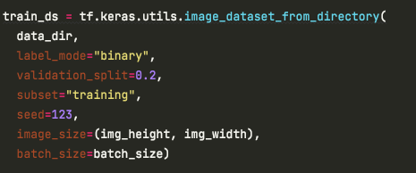
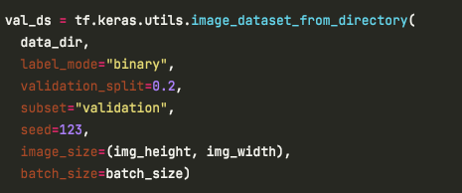
Model definition and building network:
Step 2: Prepare Dataset for Training
Create Training & Validation Data:
We divided the data into two groups: one for training and the other for model validation in a ratio of 80/20.

Slide 13
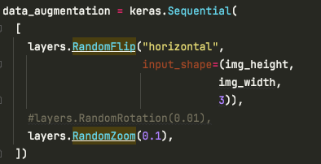
Model definition and building network:
Step 3: Images Augmentation:
Create a sperate layer of Image augmentation and added later to CNN Architectures utilizing the GPU.

Slide 14
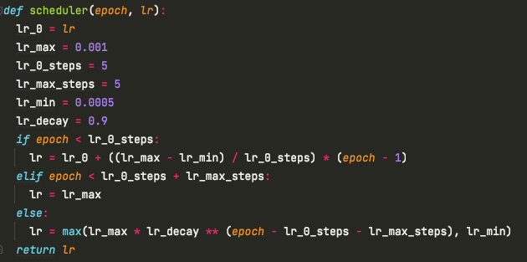
Model definition and building network:
Step 4: Scheduler:
Create a Scheduler function that help to dynamically assign Learning Rates while the model optimizing the weights, although some optimizer like “Adam” has built-in features to adjust the “LR” while the training process.

Slide 15
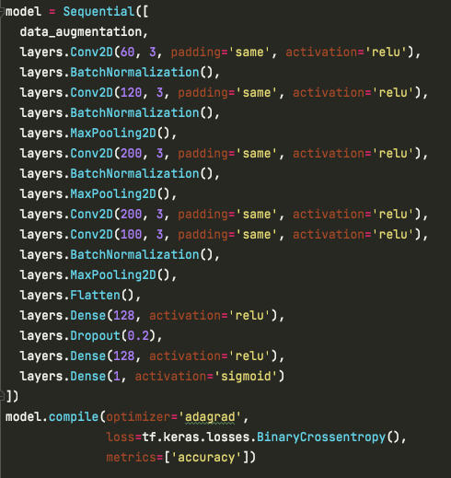
Model definition and building network:
Step 5 : Build the convolutional neural network
In this step we define the convolutional neural network where the convolution, Pooling, and Fattening layers will be applied. We also added Dropout layer to reduce overfitting. Since it’s a binary class problem, the Sigmoid activation function is applied in the last layer.

Slide 16
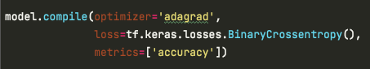
Model definition and building network:
Step 6: Compiling the model :
In this step we define the convolutional neural network where the The next step is to compile the model. The Binary Crossentropy loss is used because the labels are binary. In the event that you want to encode the labels, then you will have to use the Categorical Cross-Entropy loss function.

Slide 17
Model definition and building network:
Step 7 : Early Stopping, Model Check Point :
Early stopping: To avoid that is to stop the training process when the model stops improving
Model Check Point : automatically saving the best model or model weights during training

Slide 18
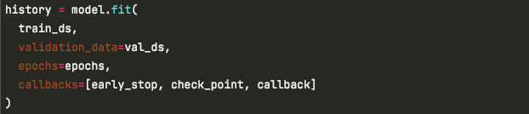
Model definition and building network:
Step 8: Training the model
Now we are ready to fit the data to the training set. The model is set to run for 50 epochs but the process will be stopped by the callback when the loss doesn’t improve after 5 epochs as we defined in the Early Stopping callback.

Slide 19
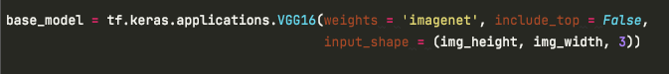
Model definition and building network:
Pretrained Model:
In this project we used transfer learning choose to use VGG16 model using Keras API. This model and others like (Xception, ResNet50 & MobileNet) have been pre-trained on the ImageNet dataset which has over million images.

